Slide 1
Application of TDMI on Analyzing Neural Data(III)
Kai Chen
9/26/2018

Slide 2
Time-delayed Mutual information(TDMI)
$$I\left(τ\right)=I\left(X(t);Y\left(t+τ\right)\right)=\sum_{x∈X\left(t\right)}{\sum_{y∈Y\left(t+τ\right)}{p\left(x,y\right)log\frac{p\left(x,y\right)}{p\left(x\right)p\left(y\right)}}}$$
For random series X and Y,
$$\left\{\begin{aligned}X_{i}=f(X_{i−1}, Y_{i−1}) \\ Y_{i}=g(X_{i−1}, Y_{i−1})\end{aligned}\right.$$
$$X_{n−2}$$
$$X_{n−1}$$
$$X_{n}$$
$$X_{n+1}$$
$$X_{n+2}$$
$$τ=−2$$
$$τ=−1$$
$$τ=0$$
$$τ=1$$
$$τ=2$$
$$Y_{n−2}$$
$$Y_{n−1}$$
$$Y_{n}$$
$$Y_{n+1}$$
$$Y_{n+2}$$

Slide 3
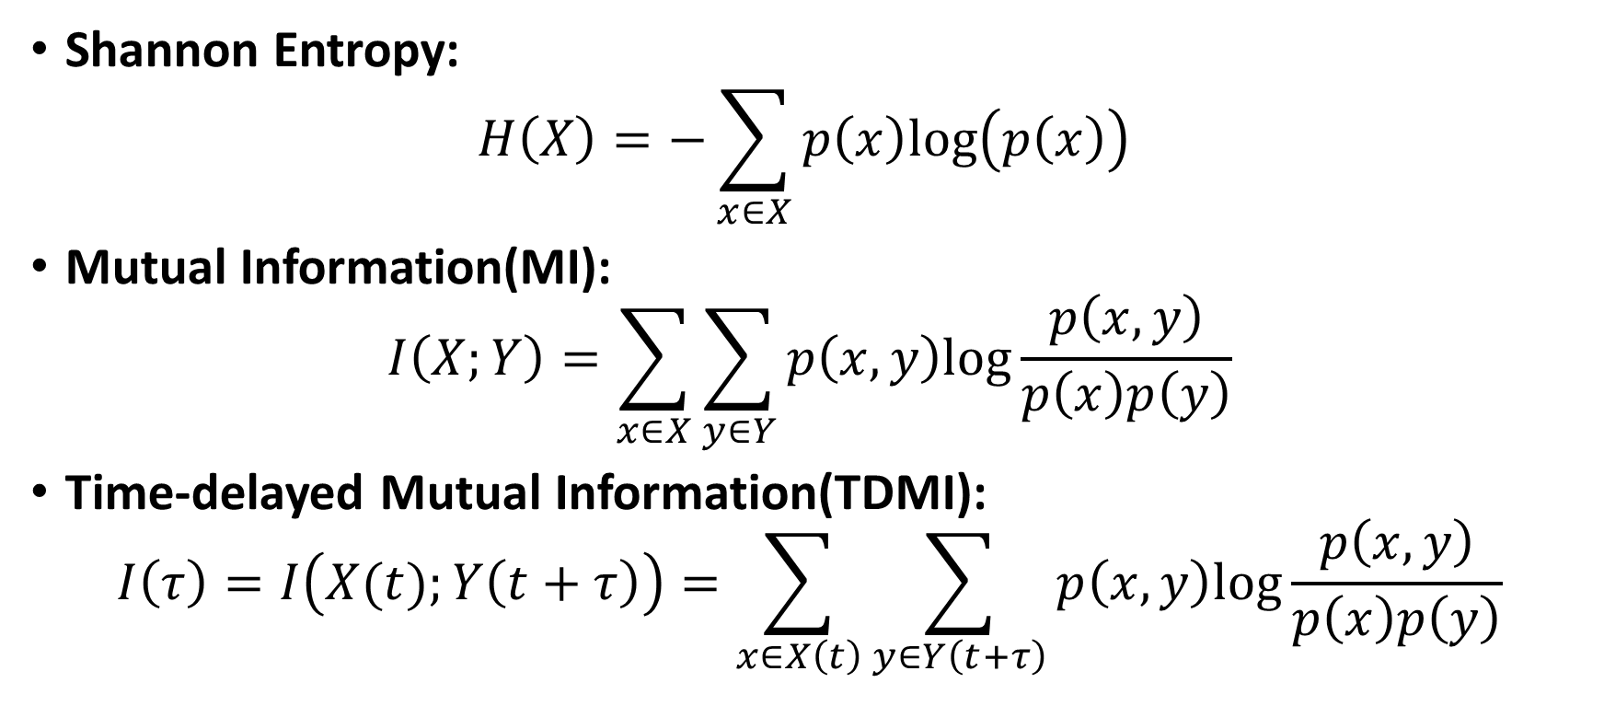
Review about mutual information
Shannon Entropy:
$$H\left(X\right)=−\sum_{x∈X}{p\left(x\right)log\left(p\left(x\right)\right)}$$
Mutual Information(MI):
$$I\left(X;Y\right)=\sum_{x∈X}{\sum_{y∈Y}{p\left(x,y\right)log\frac{p\left(x,y\right)}{p\left(x\right)p\left(y\right)}}}$$
Time-delayed Mutual Information(TDMI):
$$I\left(τ\right)=I\left(X(t);Y\left(t+τ\right)\right)=\sum_{x∈X\left(t\right)}{\sum_{y∈Y\left(t+τ\right)}{p\left(x,y\right)log\frac{p\left(x,y\right)}{p\left(x\right)p\left(y\right)}}}$$

Slide 4
Mutual information(MI)
Define:
$$I\left(X;Y\right)=\sum_{x∈X}{\sum_{y∈Y}{p\left(x,y\right)log\frac{p\left(x,y\right)}{p\left(x\right)p\left(y\right)}}}$$
$I\left(X;Y\right)=H\left(X\right)−H\left(X | Y\right)=H\left(Y\right)−H\left(Y | X\right)$
$I\left(X;Y\right)=H\left(X\right)+H\left(Y\right)−H(X,Y)$
$I\left(X;Y\right)=0$ if X and Y are independent
$I\left(X;X\right)=H\left(X\right)$

Slide 5
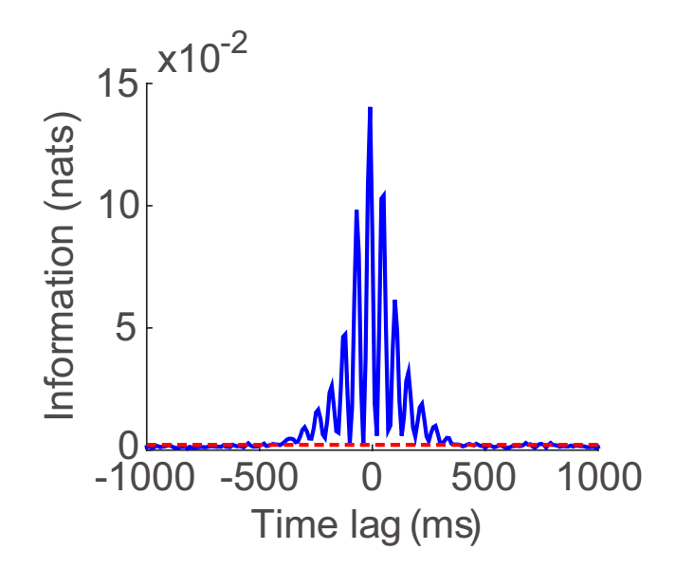
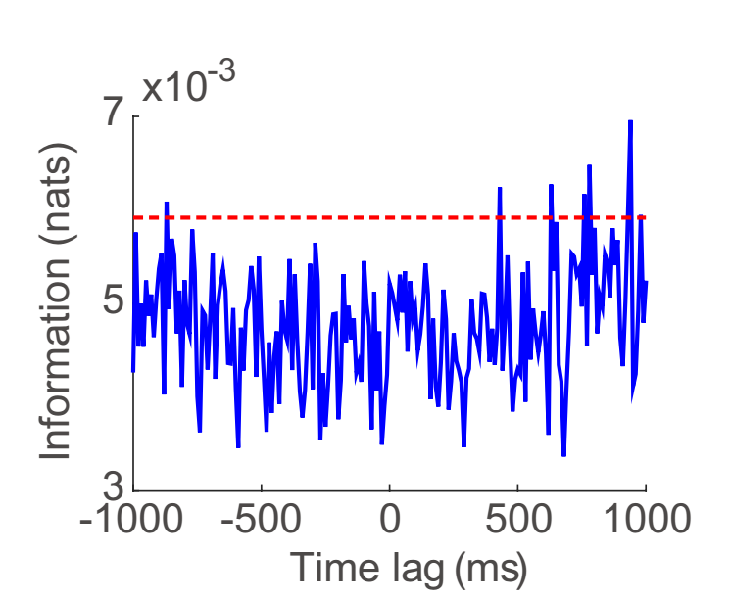
Experimental Background
LFP
theta-driving neuron
non theta-driving neuron
The characterization of hippocampal theta-driving neurons — a time-delayed mutual information approach
Songting Li, Jiamin Xu, Guifen Chen, Longnian Lin, Douglas Zhou & David Cai

Slide 6
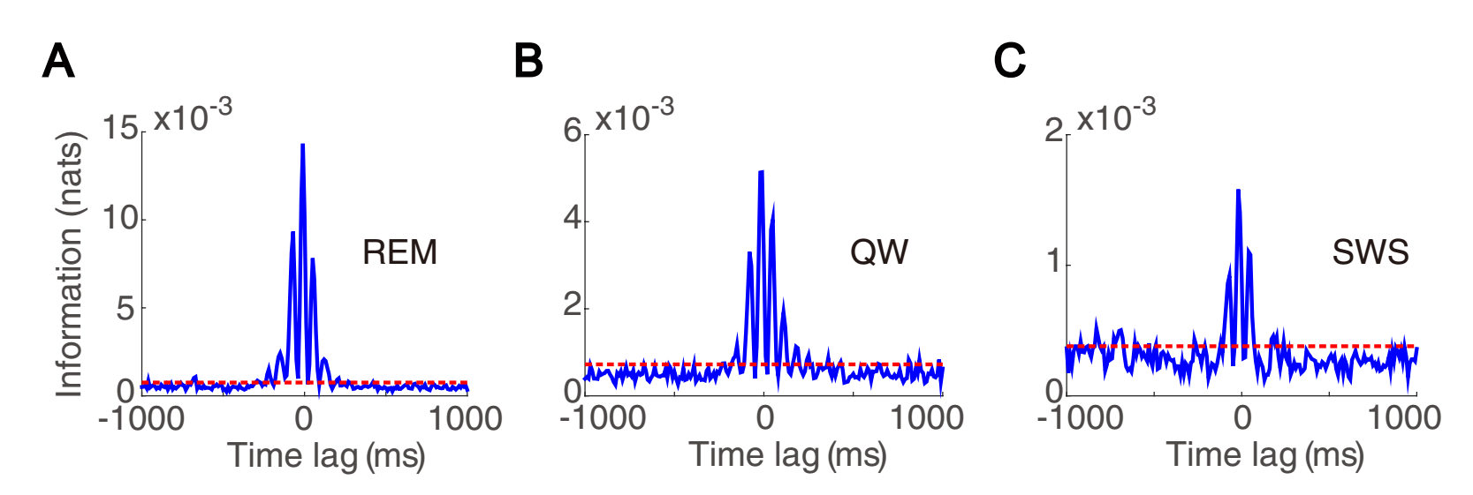
Experimental Background
The characterization of hippocampal theta-driving neurons — a time-delayed mutual information approach
Songting Li, Jiamin Xu, Guifen Chen, Longnian Lin, Douglas Zhou & David Cai

Slide 7
Questions
Whether TDMI indicates the real physical connection?
How does it do that?
What’s the relationship between physical interaction and MI signal?

Slide 8
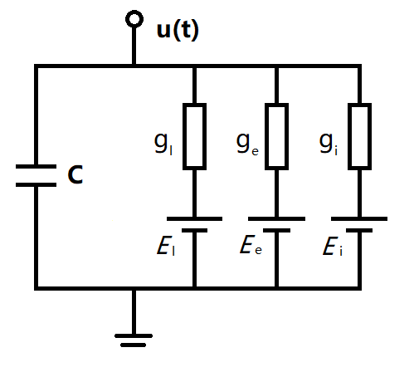
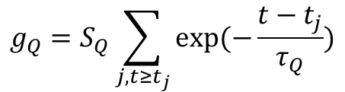


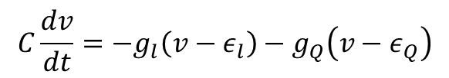

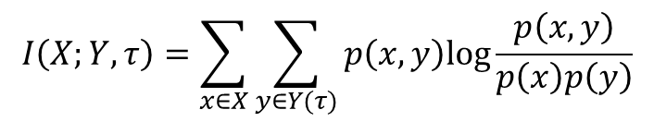
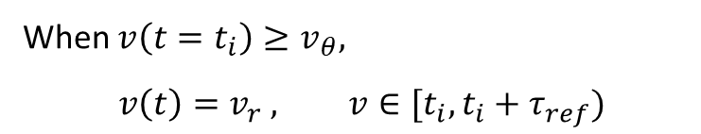
Model System
Spike Train
dt
0 0 0 0 1 0 0 0 1 0 0 0 0 1 0 1
X
Conductance-based Integrate-and-fire model:
Local Field Potential
$$I_{t_{1}}, I_{t_{2}},I_{t_{3}},I_{t_{4}},I_{t_{5}},I_{t_{6}},…,I_{t_{n}}$$
Y
$$I\left(X;Y, τ\right)=\sum_{x∈X}{\sum_{y∈Y(τ)}{p\left(x,y\right)log\frac{p\left(x,y\right)}{p\left(x\right)p\left(y\right)}}}$$
$$C\frac{dv}{dt}=−g_{l}\left(v−ε_{l}\right)−g_{Q}\left(v−ε_{Q}\right)$$
$$Q∈\left\{e,i\right\}$$
$$g_{Q}=S_{Q}\sum_{j, t≥t_{j}}{exp⁡(−\frac{t−t_{j}}{τ_{Q}})}$$
$$I_{real}≅I_{obs}+\frac{B_{X}+B_{Y}−B_{XY}−1}{2N}$$
When $v\left(t=t_{i}\right)≥v_{θ},$
$$v\left(t\right)=v_{r} , v∈[t_{i}, t_{i}+τ_{ref})$$
Roulston, M. S. (1999).
Estimating the errors on measured entropy and mutual information.
Notes:
讲一下参数

Slide 9
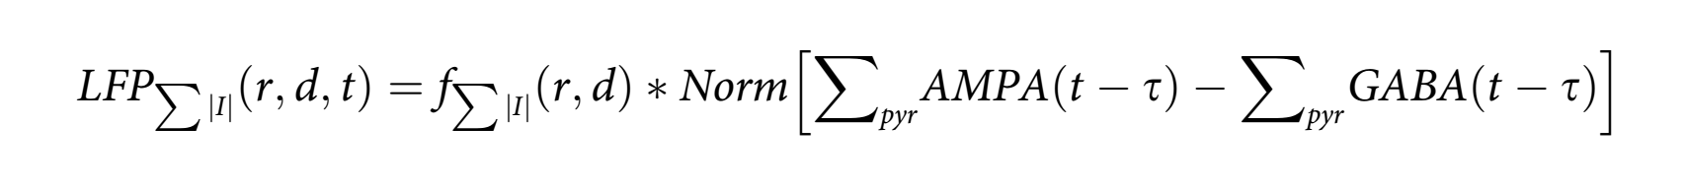
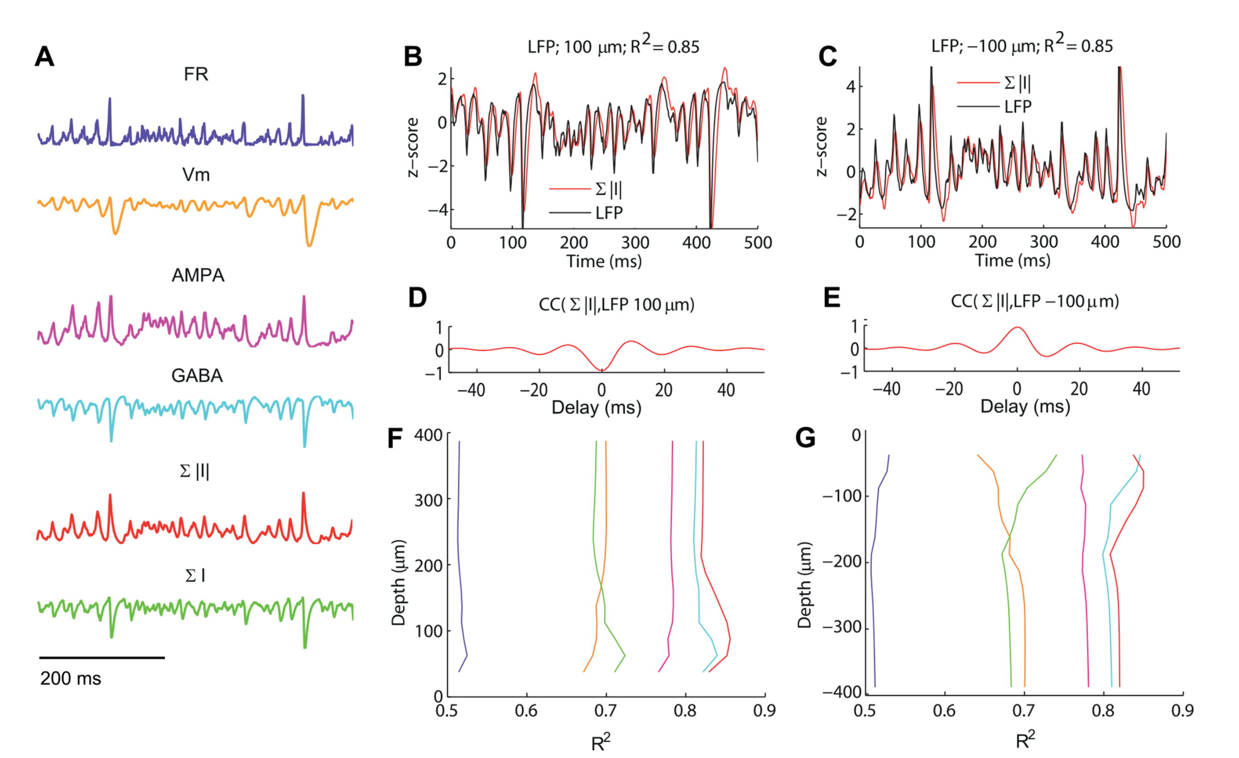
LFP Model
Mazzoni, A., Lindén, H., Cuntz, H., Lansner, A., Panzeri, S., & Einevoll, G. T. (2015). Computing the local field potential (LFP) from integrate-and-fire network models. PLoS computational biology, 11(12), e1004584.

Slide 10
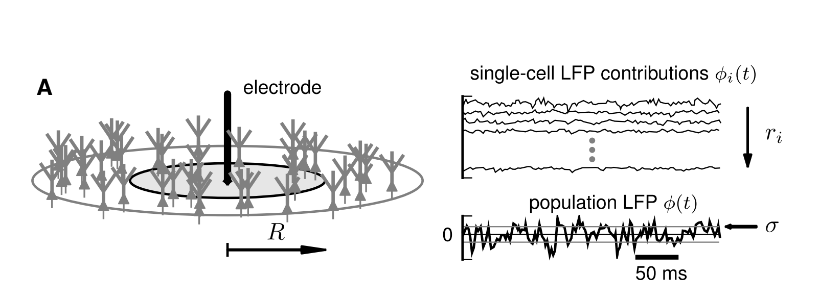

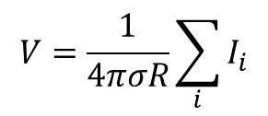
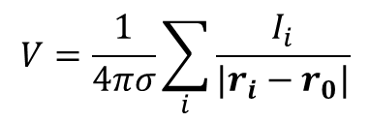

LFP Model – Point Current model
‘Point source’ current model of local field potential:
Electrode
$$V=\frac{1}{4πσ}\sum_{i}{\frac{I_{i}}{|r_{i}−r_{0}|}}$$
$$V=\frac{1}{4πσR}\sum_{i}{I_{i}}$$
R
$$I=−g_{l}\left(v−ε_{l}\right)−g_{Q}\left(v−ε_{Q}\right)$$
$$Q∈\left\{e,i\right\}$$
Lindén, H., Tetzlaff, T., Potjans, T. C., Pettersen, K. H., Grün, S., Diesmann, M., & Einevoll, G. T. (2011).
Modeling the spatial reach of the LFP. Neuron, 72(5), 859-872.

Slide 11
Neuronal Interaction layout
spike 1
spike 2
$${10}^{−4}$$
0
1
$${10}^{−4}$$
$${10}^{−2}$$
$${10}^{−2}$$
$${10}^{−5}$$
current 1
current 2

Slide 12
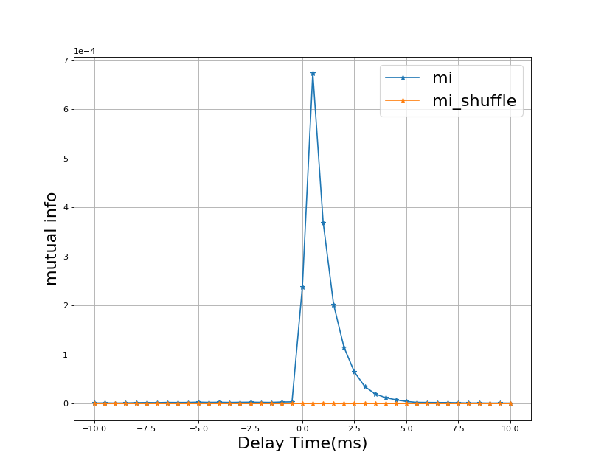
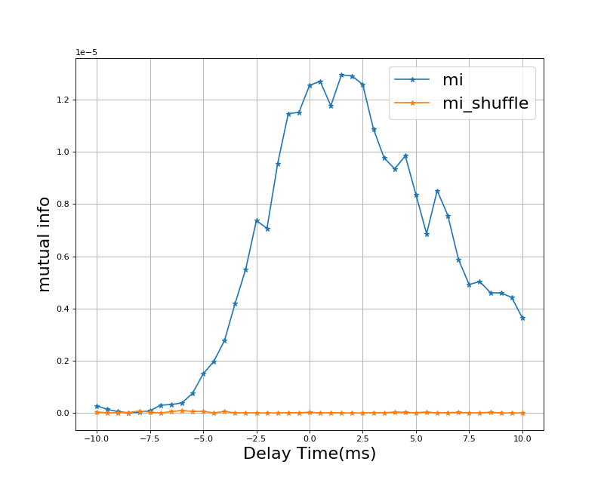
Numerical Result
1
S
2
S=5e-3 (0.5mV)
T=1e7 ms
MI from 1 to 2
MI from 2 to 1

Slide 13
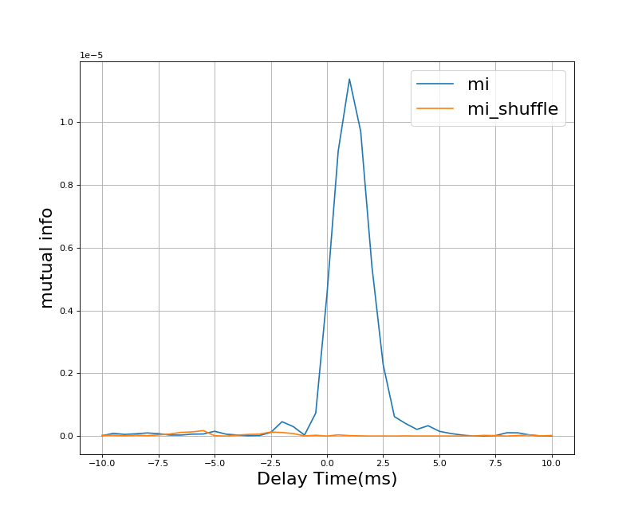
Numerical Result

Slide 14
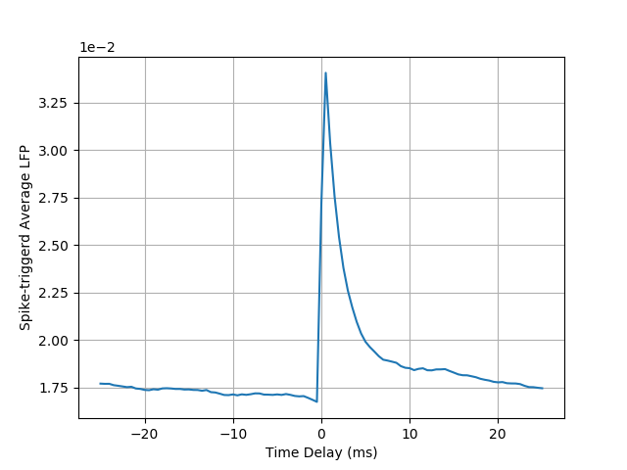
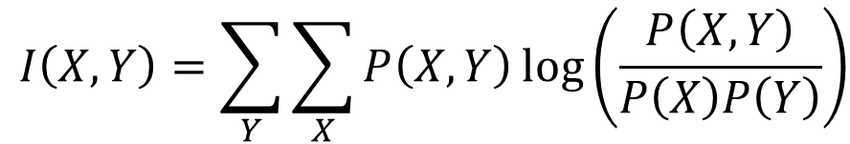

How it works
$$I\left(X,Y\right)=\sum_{Y}{\sum_{X}{P\left(X,Y\right)\log\left(\frac{P\left(X,Y\right)}{P\left(X\right)P\left(Y\right)}\right)}}$$
1
S
2
X
0
1
Y
P(0,0) | P(1,0)
P(0,1) | P(1,1)
S = 0.56 mV
LFP < threshold
(denote as 0)
LFP >= threshold
(denote as 1)
$$θ=1.8e−2$$

Slide 15
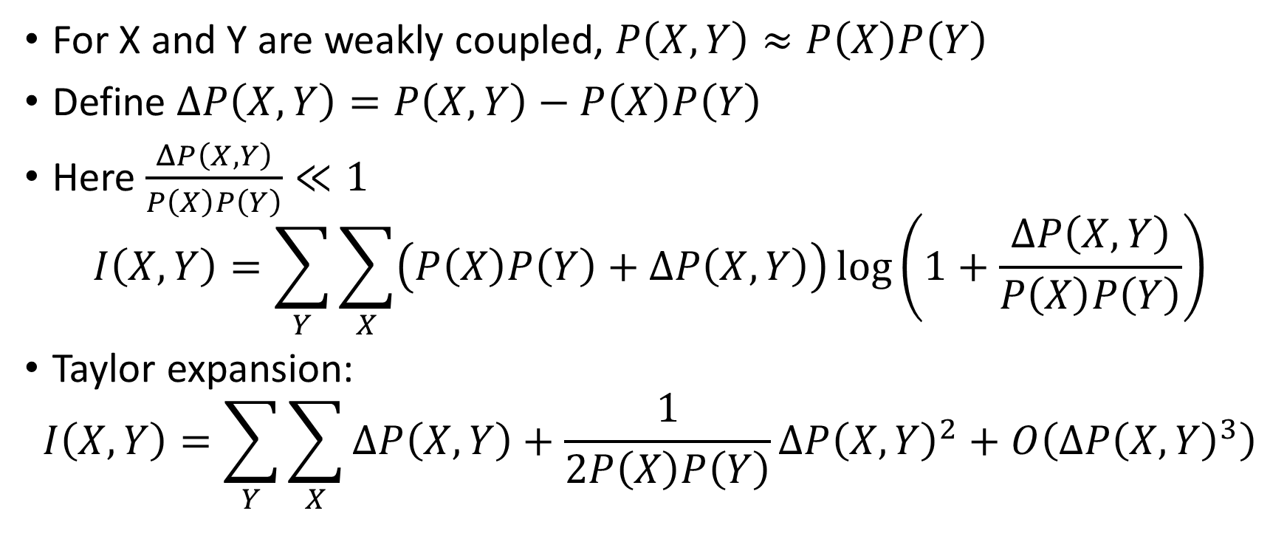
How it works
For X and Y are weakly coupled, $P\left(X,Y\right)≈P\left(X\right)P\left(Y\right)$
Define $ΔP\left(X,Y\right)=P\left(X,Y\right)−P\left(X\right)P\left(Y\right)$
Here $\frac{ΔP\left(X,Y\right)}{P\left(X\right)P\left(Y\right)}≪1$
$$I\left(X,Y\right)=\sum_{Y}{\sum_{X}{\left(P\left(X\right)P\left(Y\right)+ΔP\left(X,Y\right)\right)\log\left(1+\frac{ΔP\left(X,Y\right)}{P\left(X\right)P\left(Y\right)}\right)}}$$
Taylor expansion:
$$I\left(X,Y\right)=\sum_{Y}{\sum_{X}{ΔP\left(X,Y\right)+\frac{1}{2P\left(X\right)P\left(Y\right)}ΔP{\left(X,Y\right)}^{2}+O\left(ΔP{\left(X,Y\right)}^{3}\right)}}$$

Slide 16
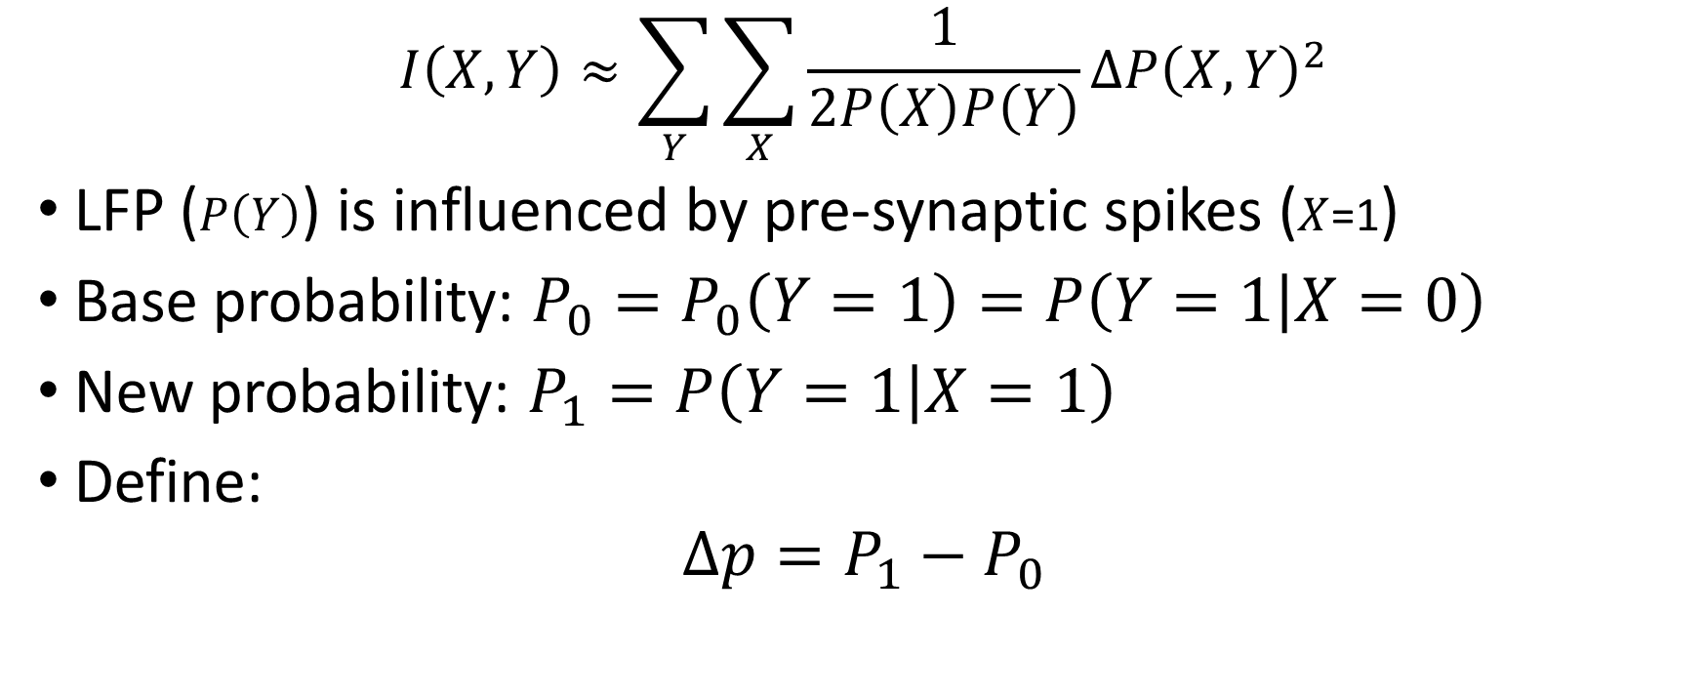
How it works
$$I\left(X,Y\right)≈\sum_{Y}{\sum_{X}{\frac{1}{2P\left(X\right)P\left(Y\right)}ΔP{\left(X,Y\right)}^{2}}}$$
LFP ($P\left(Y\right)$) is influenced by pre-synaptic spikes ($X$=1)
Base probability: $P_{0}=P_{0}\left(Y=1\right)=P\left(Y=1 | X=0\right)$
New probability: $P_{1}=P\left(Y=1 | X=1\right)$
Define:
$$Δp=P_{1}−P_{0}$$

Slide 17
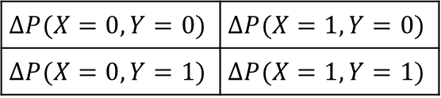
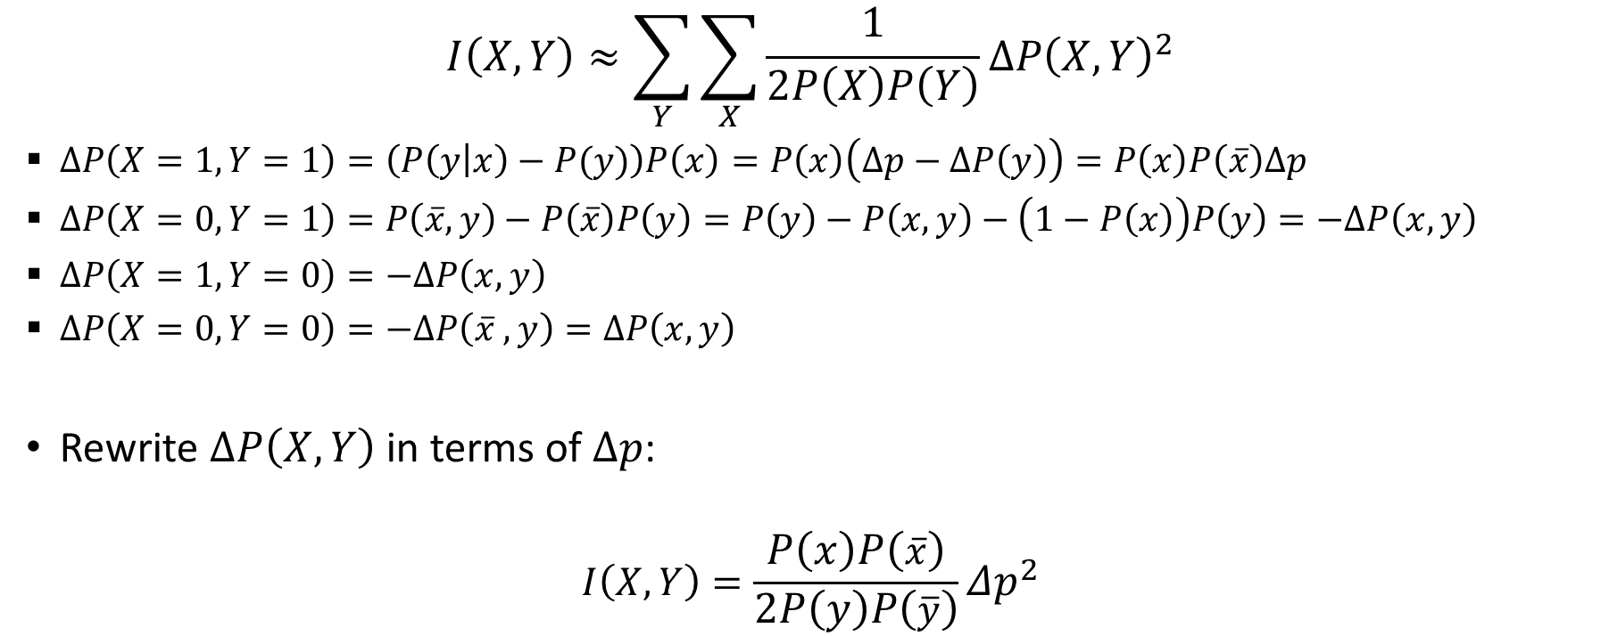


How it works
Y
X
0
1
LFP < threshold(denote as 0)
$$ΔP(X=0,Y=0)$$ | $$ΔP(X=1,Y=0)$$
$$ΔP(X=0,Y=1)$$ | $$ΔP(X=1,Y=1)$$
LFP >= threshold(denote as 1)
$$I\left(X,Y\right)≈\sum_{Y}{\sum_{X}{\frac{1}{2P\left(X\right)P\left(Y\right)}ΔP{\left(X,Y\right)}^{2}}}$$
$ΔP\left(X=1,Y=1\right)=\left(P\left(y | x\right)−P(y)\right)P\left(x\right)=P\left(x\right)\left(Δp−ΔP\left(y\right)\right)=P\left(x\right)P\left(\overline{x}\right)Δp$
$ΔP\left(X=0,Y=1\right)=P\left(\overline{x},y\right)−P\left(\overline{x}\right)P\left(y\right)=P\left(y\right)−P\left(x,y\right)−\left(1−P\left(x\right)\right)P\left(y\right)=−ΔP\left(x,y\right)$
$ΔP\left(X=1,Y=0\right)=−ΔP\left(x,y\right)$
$ΔP\left(X=0,Y=0\right)=−ΔP\left(\overline{x} ,y\right)=ΔP\left(x,y\right)$
Rewrite $ΔP\left(X,Y\right)$ in terms of $Δp$:
$$I\left(X,Y\right)={\frac{P\left(x\right)P\left(\overline{x}\right)}{2P\left(y\right)P\left(\overline{y}\right)}Δp}^{2}$$
$$ΔP\left(X=0\right)=ΔP\left(X=1\right)=0$$
Denote:
$$P\left(X=1\right)=P(x)$$
$$P\left(X=0\right)=P(\overline{x})$$
$$P\left(Y=1\right)=P(y)$$
$$P\left(Y=0\right)=P(\overline{y})$$

Slide 18
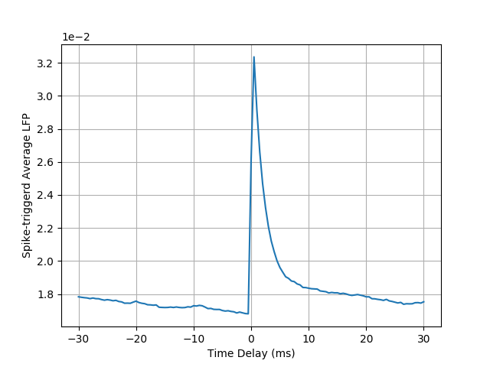
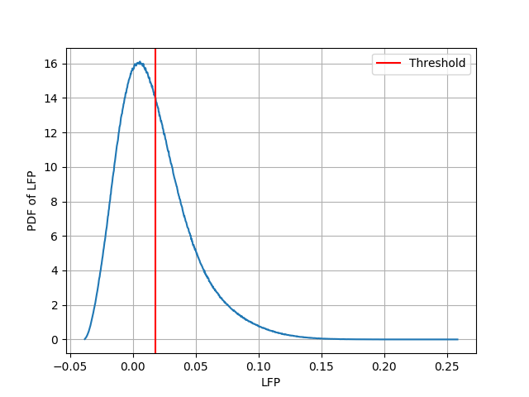
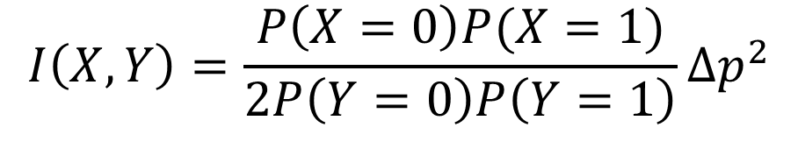

Synaptic strength
$$I\left(X,Y\right)={\frac{P\left(X=0\right)P(X=1)}{2P\left(Y=0\right)P\left(Y=1\right)}Δp}^{2}$$
$$Δp= P\left(Y=1 | X=1\right)−P_{0}\left(Y=1\right)$$
$P_{0}\left(Y=1\right)=\int_{θ}^{+∞}{f}\left(y\right)dy$ $P\left(Y=1 | X=1\right)=\int_{θ−∆y}^{+∞}{f}\left(y\right)dy$
$$Δp=\int_{θ−Δy}^{θ}{f}\left(y\right)dy≈f\left(θ\right)Δy$$
Since $Δy∝S,$
$$Δy∝S$$
$$Δp∝S$$
$$I\left(X,Y\right)∝S^{2}$$

Slide 19
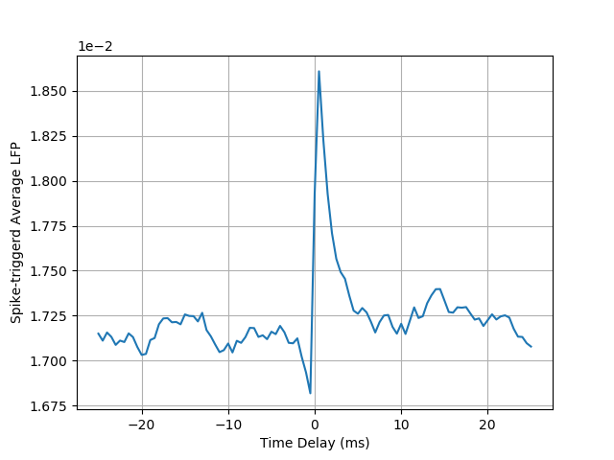
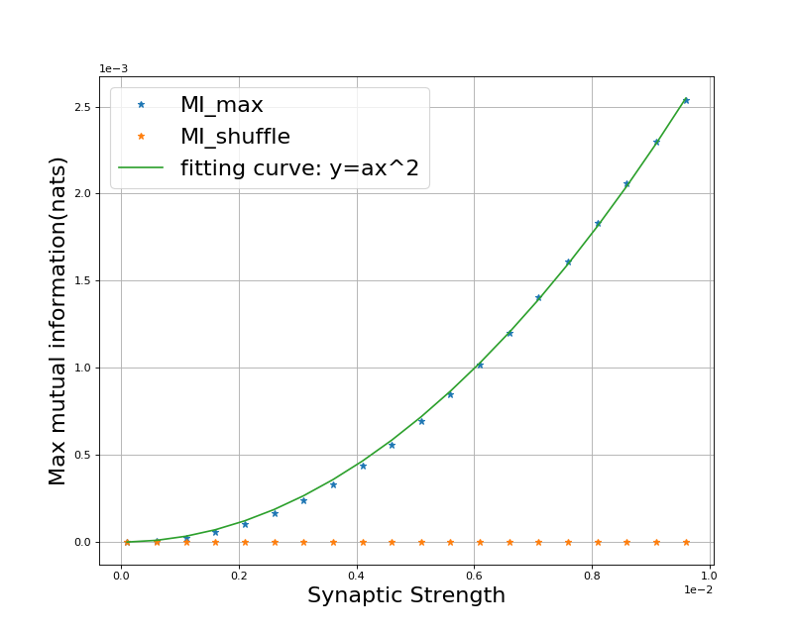
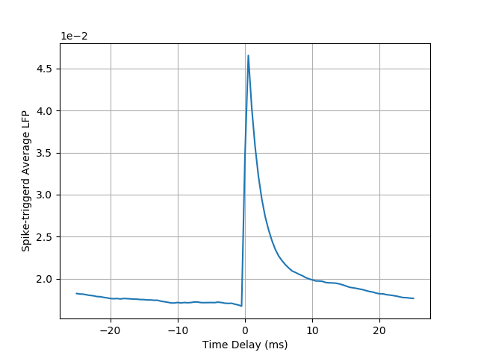
Max(MI) vs. Synaptic Strength
STA for different Synaptic Strength
0.06 mV
0.56 mV
0.96 mV

Slide 20
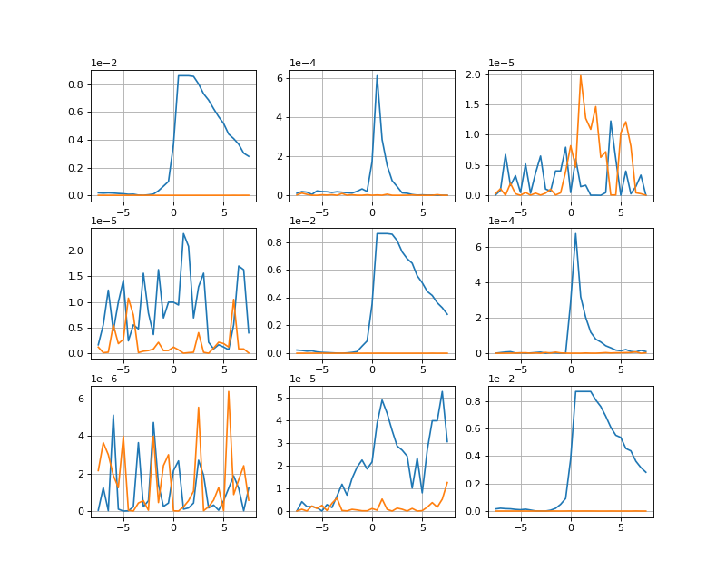
Three neuron system – Mode 1
Mutual information (nats)
2
1
3
Time delay (ms)

Slide 21
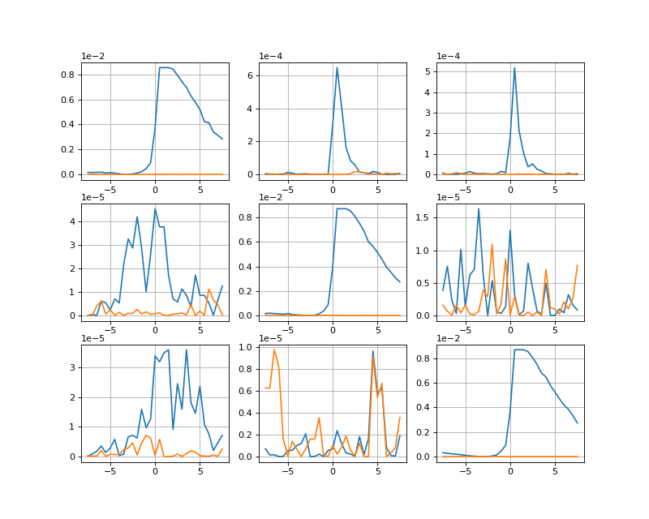
Three neuron system – Mode 2
Mutual information (nats)
1
2
3
Time delay (ms)

Slide 22
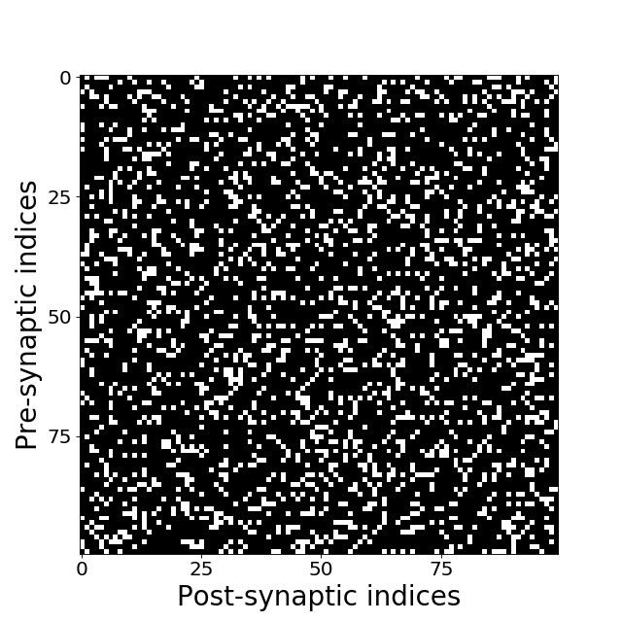
Network Setups
100 excitatory neurons
Connectivity probability(p):
Randomly connected by 20%
Homogeneous Poisson input rate($ν$):
1.3 kHz
Poisson strength(f):
5e-3 (Roughly 0.5mV EPSP for 15mV subthreshold range of voltage)
Refractory period = 2ms
Time constant of GE = 2ms
Time delay of synaptic interactions = 0 ms

Slide 23
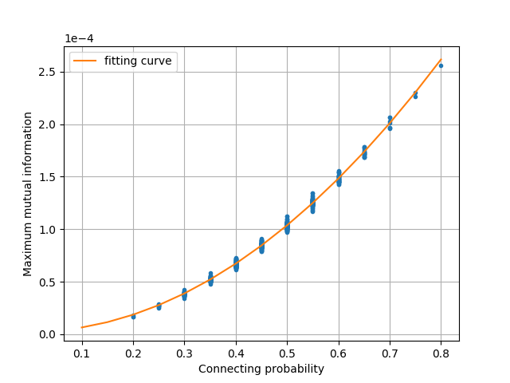
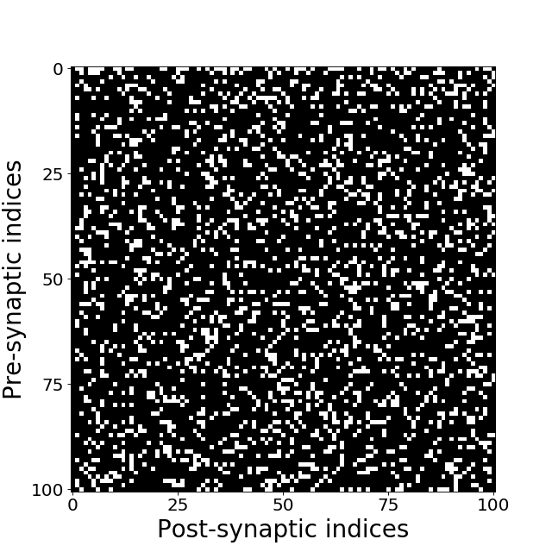
LFP-driving neuron
500 LFP samples
LFP generated by 20 individual neurons
Length of time series 1e7 ms
20% random connecting prob.
Max(MI) vs. Connecting Rate

Slide 24
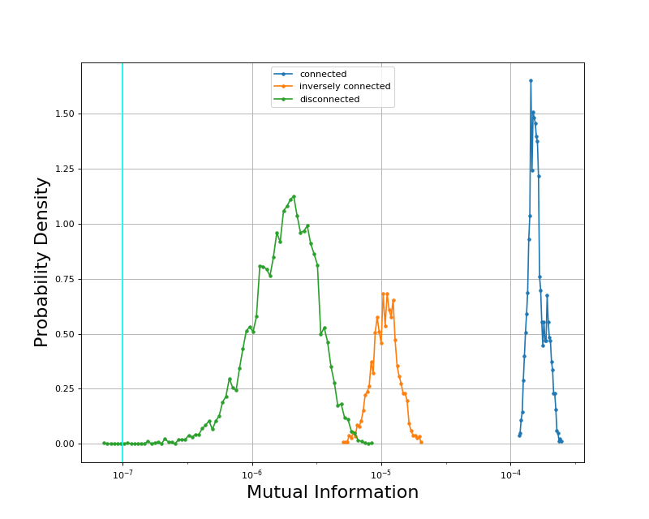
Network reconstruction
MI from 1 to 2
Spike train
LFP
Type I:
1
2
Type II:
1
2
Type III:
1
2

Slide 25
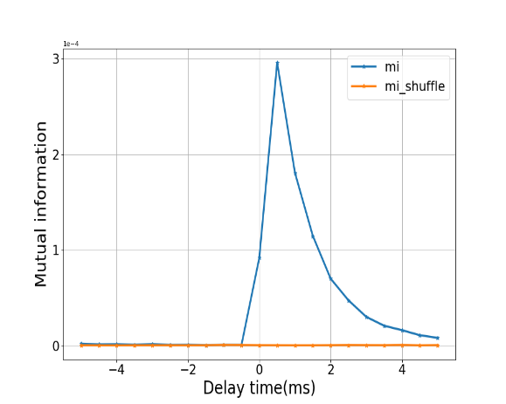
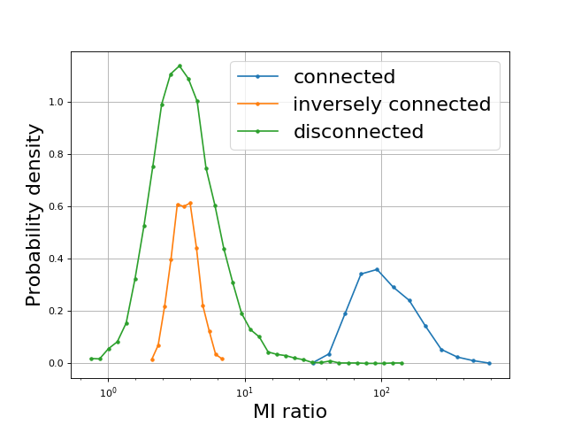
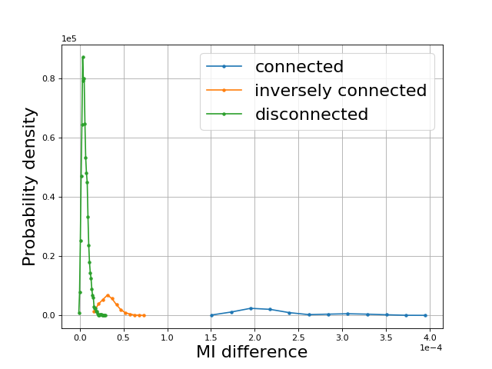
Network reconstruction

Slide 26
Next step
Add new parameters into LFP model
Mix-types of neurons in network
Spatial distribution of neurons (Filtering effect)
Tuning the network into theta band oscillatory state
How does TDMI work with LFPs in oscillatory state

Slide 27
Thanks for attention

Slide 28
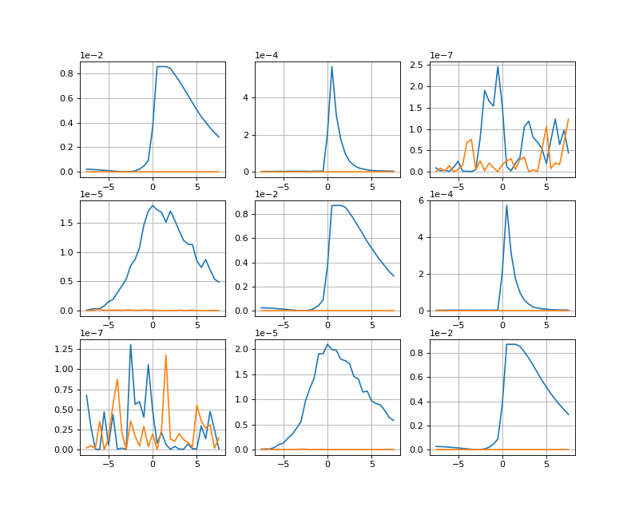
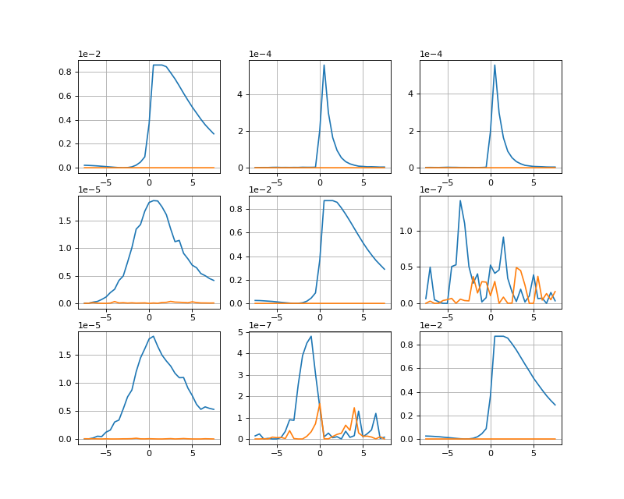
Three neuron system
T=1e7ms
Mode 1
Mode 2

Slide 29
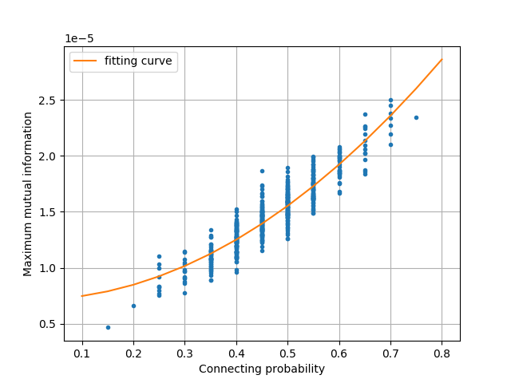
LFP-driven neuron
Max(MI) vs. Connecting Rate

